Slide 1

Bus and Memory Transfers; Instruction Cycle
Computer Organization and Architecture | Register Organization
Course: Computer Organization and Architecture | Chapter: Register Organization | Bachelor of Engineering
DISCOVER · LEARN · EMPOWER
Notes:
Welcome everyone to today's lecture on Computer Organization. We are focusing specifically on the Register Organization chapter, diving deep into how data moves. Today we will explore the critical mechanisms of bus transfers and the fundamental instruction cycle that drives our processors.

Slide 2
Course Outcomes
SLIDE 2 / 10
Course Outcome
CO | BT LEVEL | DESCRIPTION
CO1 | BT3 | Apply number systems and digital logic to design basic digital circuits
CO2 | BT4 | Analyze register organization and instruction set architecture
CO3 | BT3 | Implement computer arithmetic algorithms and floating-point operations
CO4 | BT5 | Analyze memory hierarchy and input-output organization
CO5 | BT6 | Evaluate control unit design and pipelining performance
Chandigarh University
2 / 10
Notes:
Our primary learning outcome for this session is CO2. You must be able to analyze how register organization interacts with the instruction set architecture. This means understanding not just the components, but how they function together during data transfers.

Slide 3
Learning Objectives
SLIDE 3 / 10
Learning Outcomes
1
Analyze the role of system buses in transferring data between registers and memory.
2
Evaluate the sequence of steps involved in the basic instruction cycle.
3
Differentiate between various bus transfer operations like read and write cycles.
4
Apply the instruction cycle model to trace program execution flow.
Chandigarh University
3 / 10
Notes:
By the end of this session, you will be able to analyze how buses facilitate data movement. You will evaluate the step-by-step instruction cycle and differentiate between read and write operations. Finally, you will apply these models to trace how a simple program executes.

Slide 4
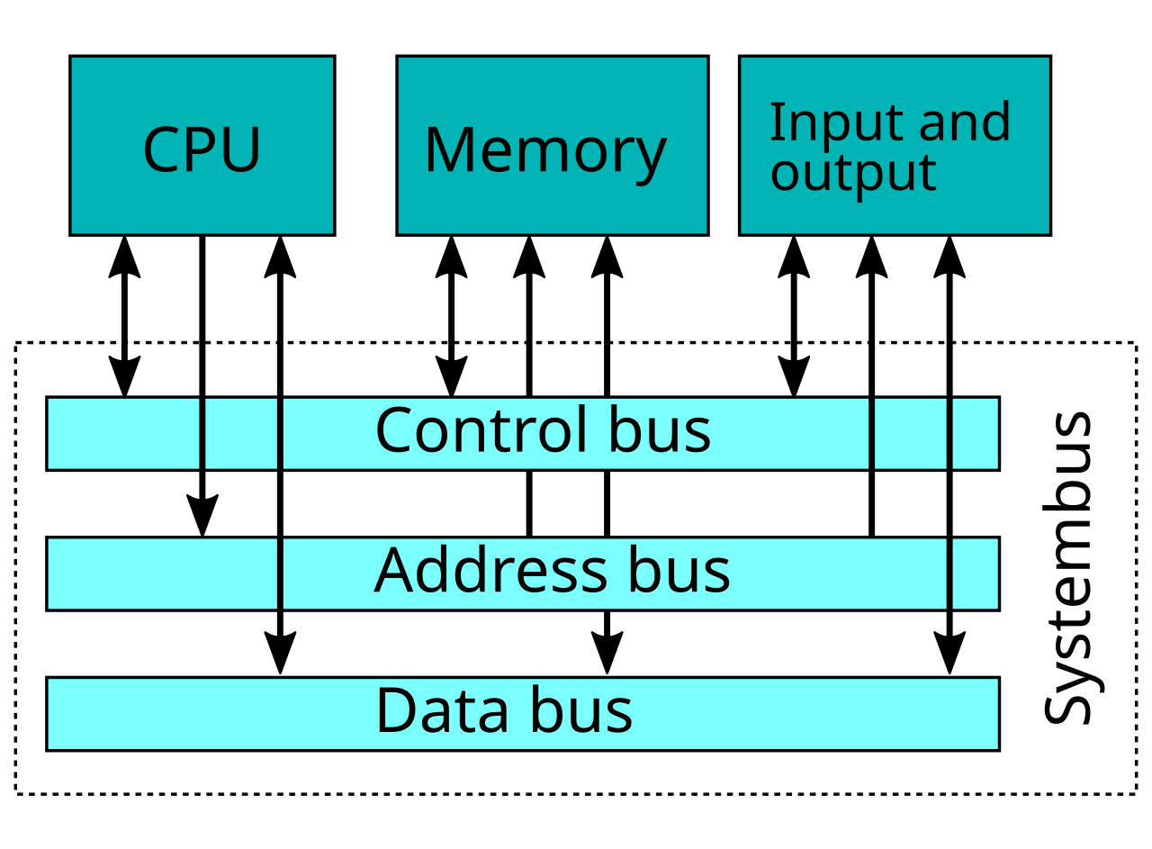
Lecture
SLIDE 4 / 10
System Bus Fundamentals
1
The system bus consists of data, address, and control lines connecting components.
2
Data bus carries actual information between CPU, memory, and I/O devices.
3
Address bus specifies the source or destination location for data transfers.
4
Control bus manages timing and signals like read, write, and interrupt requests.
System bus - Wikipedia
Chandigarh University
4 / 10
Notes:
Think of the system bus as the highway system of the computer. The data bus carries the cargo, the address bus provides the destination coordinates, and the control bus acts as the traffic signals. Without these three distinct lines, coordinated data transfer would be impossible.

Slide 5
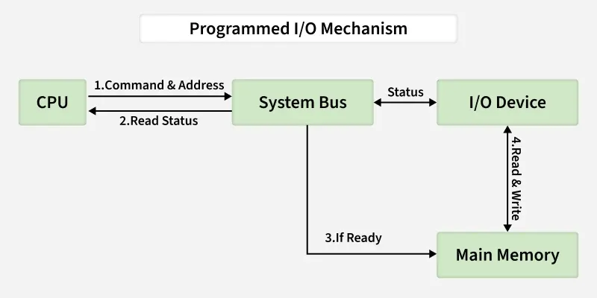
Lecture
SLIDE 5 / 10
Bus Transfer Operations
1
A read operation transfers data from a memory location to a register.
2
A write operation transfers data from a register to a memory location.
3
The CPU places the target address on the address bus before any transfer.
4
The control line signals the direction of data flow during the transfer cycle.
Memory Transfer Mechanisms - GeeksforGeeks (source: media.geeksforgeeks.org)
Chandigarh University
5 / 10
Notes:
Let's look at a read operation. The CPU places an address on the bus, asserts a read signal, and data flows from memory to the register. Conversely, for a write, the CPU puts data on the bus and asserts a write signal to store it. The address must always be valid before the data moves.

Slide 6
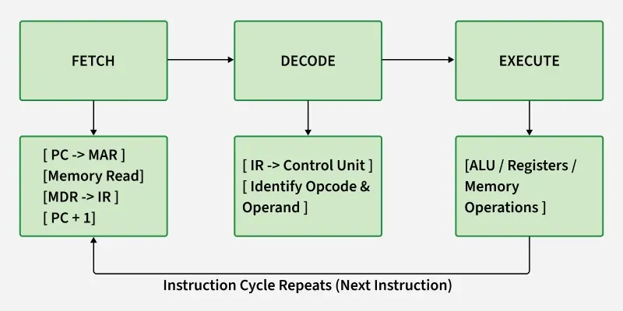
Lecture
SLIDE 6 / 10
Instruction Cycle Phases
1
The instruction cycle repeats continuously to execute a program stored in memory.
2
Fetch phase retrieves the instruction from memory into the instruction register.
3
Decode phase interprets the instruction to determine the required operation.
4
Execute phase performs the operation and updates the status of registers.
Primary Instruction Cycles - GeeksforGeeks (source: media.geeksforgeeks.org)
Chandigarh University
6 / 10
Notes:
The processor operates in a loop called the instruction cycle. First, it fetches the instruction, then decodes what it means, and finally executes the action. This cycle repeats millions of × per second. It is the heartbeat of the computer organization.

Slide 7
Lecture
SLIDE 7 / 10
Instruction Cycle Timing
1
Each phase of the instruction cycle takes a specific number of clock cycles.
2
Fetch time depends on memory access speed and bus transfer latency.
3
Decode time is determined by the complexity of the instruction set.
4
Execute time varies based on whether the operation is arithmetic or memory access.
Primary Instruction Cycles - GeeksforGeeks (source: media.geeksforgeeks.org)
Chandigarh University
7 / 10
Notes:
Timing is crucial for performance. A simple fetch might take one clock cycle, while a complex memory access could take several. If the memory is slow, the fetch phase becomes a bottleneck. Understanding these timings helps us analyze the overall speed of the system.

Slide 8
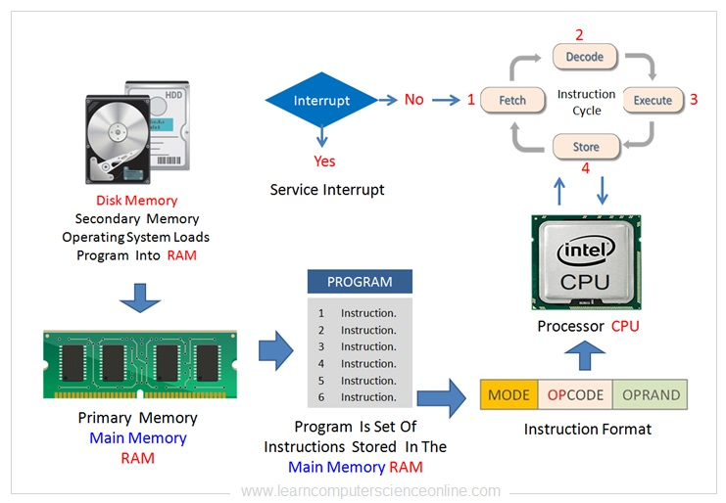
Worked Example
SLIDE 8 / 10
Fetch Cycle
STEP 1
MAR receives address 100 from PC via internal bus transfer.
STEP 2
Memory read signal activates, and instruction is loaded into MDR.
STEP 3
Instruction moves from MDR to IR, and PC increments to 101.
• Assume Program Counter (PC) holds address 100 and instruction is at 100.
Computer Organization And Architecture | Beginners COA Tutorial (source: www.learncomputerscienceonline.com)
Chandigarh University
8 / 10
Notes:
Let's trace a fetch cycle. If the PC holds 100, the address goes to the Memory Address Register. The memory reads the instruction and puts it in the Memory Data Register. Finally, it moves to the Instruction Register, and the PC increments to point to the next instruction. This is a concrete example of the bus transfer in action.

Slide 9

Lecture
SLIDE 9 / 10
Key Takeaways
1
System buses are essential for all data transfers between CPU and memory.
2
Read and write operations are controlled by specific signals on the control bus.
3
The instruction cycle consists of Fetch, Decode, and Execute phases.
4
Bus transfer timing directly impacts the overall speed of the computer system.
Source: ecdn.teacherspayteachers.com
Chandigarh University
9 / 10
Notes:
To summarize, remember that buses are the lifeline of data movement. The instruction cycle is the repetitive process that drives execution. Always consider the timing of these transfers when analyzing system performance. These concepts form the foundation of computer organization.

Slide 10
Lecture
SLIDE 10 / 10
References
COMPUTER ORGANIZATION AND DESIGN
The Hardware/Software Interface — David A. Patterson, John L. Hennessy
COMPUTER ARCHITECTURE
A Quantitative Approach — John L. Hennessy, David A. Patterson
• Computer Organization and Architecture — William Stallings
• Computer System Architecture — M. Morris Mano & Rajib Mall
• Computer Organization — Carl Hamacher, Zvonko Vranesic, Safwat Zaky
Chandigarh University
10 / 10
Notes:
For further reading, I recommend the texts by Stallings and Mano for foundational concepts. Patterson and Hennessy provide excellent insights into the hardware-software interface. Hamacher's book is also a great resource for understanding computer organization in depth. Please review these chapters for your assignments.

